Slide 1

KGE 2022 - Project on CNR-Rome data
Submitted to:
Prof. Fausto Giunchiglia
Simone Bocca
(Department of Computer Engineering and Computer Science)
Presented by:
Surya Hembrom (229578)
Surbhi Malhotra (229579)
(Masters- Quantitative and Computational Biology, CIBIO)

Slide 2
PURPOSE
Integrate CNR-Rome patient’s data with synthetic patient data and medicinal data from drug databases.
Facilitate a second opinion for physician in drug prescription to a patient with comorbidities.
Make the physician aware of drugs being reassessed, or disapproved in Europe (or Italy).
Help patients keep track of their medical history.
Let hospital management handle patient’s data efficiently, increase the personalised care of the patients based on their diseases’ gravity.

Slide 3
DOMAIN OF INTEREST
Medical healthcare domain.
This study is limited only to
patients, their diseases, their visits to physician (encounter) and drug administration to the patients in CNR-Rome hospital in the city Roma .

Slide 4
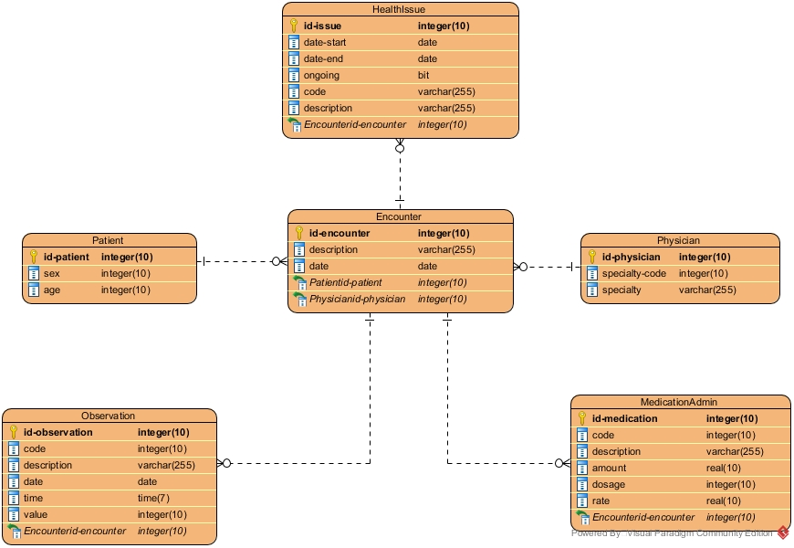
RESOURCES
Knowledge Resources:
Classes: CNR-Rome data + synthetic datasets.
Patient, Encounter, Health Issue, Medication Admin and Physician.
Add ons : Drug database , Pathology, Pharmacy, Observations and Diagnostics
www.schema.org (Medical domain)
FHIR standards for the health and medicine related terms or names.
Data Resources:
CNR-Rome data
synthetic data of the patients from the website https://synthea.mitre.org/downloads.( )
generated with https://www.bestrandoms.com/random-address-in-it.
The drug data of PharmGKB ( ) https://www.pharmgkb.org/labelAnnotations
dataset downloaded from https://www.ema.europa.eu/en/medicines/download- medicine-data under the download link of ”Download table of all EPARs for human and veterinary medicines”.
Filtered for Human

Slide 5
PURPOSE FORMALISATION
Scenarios:
Hospital management who needs to manage a patient.
Physician who needs to provide patients with principal care and consultancy.
Pharmacist who needs to manage prescriptions and drugs.
Patient who needs to process his own medical information.
Personas:
Patient
Hospital management
Physician/Clinician
Test Examiner
Pharmacist

Slide 6
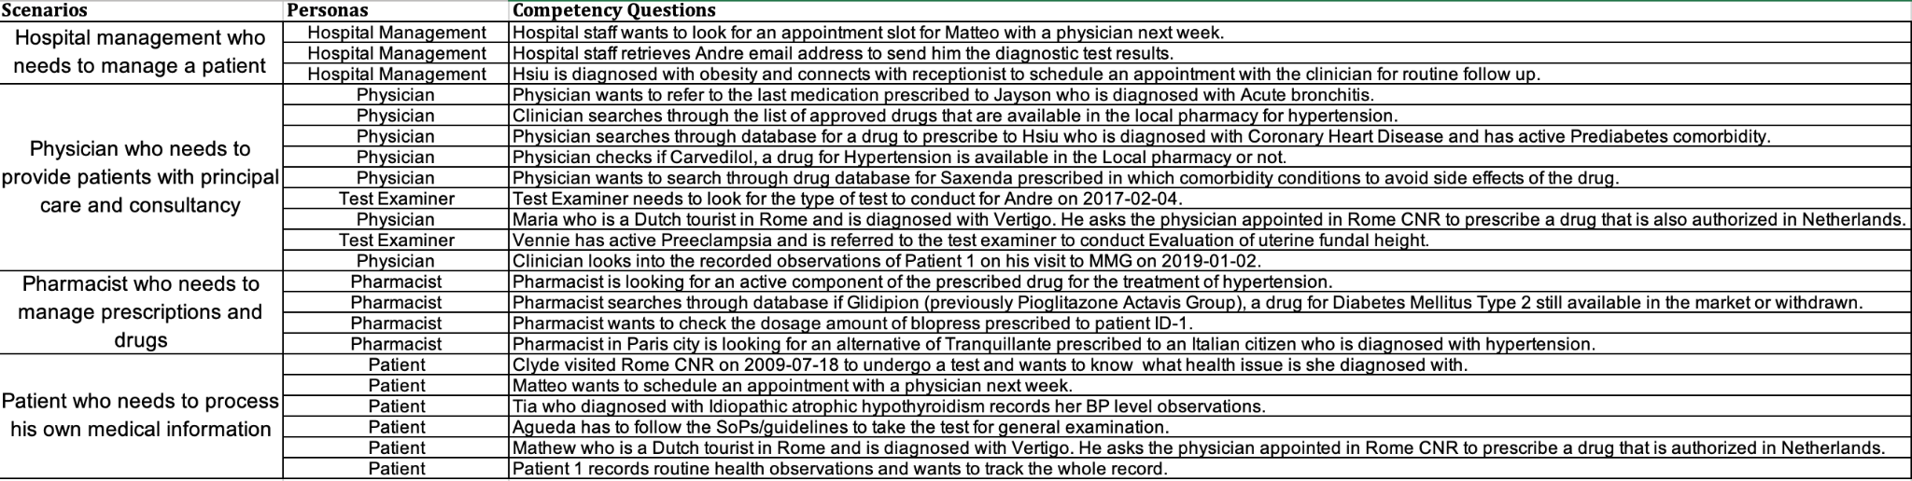
CQs:

Slide 7
Inception
Resources scraping and data filtering
Resource classification
Ontology creation for separate entities with defined data properties
Protégé
Data layer manipulation and handling
Karma tool
Iterative phase: ontology building in concordance to data layer.
Decision making phase: limit the scope of Knowledge Graph (KG) as per the data availability.

Slide 8
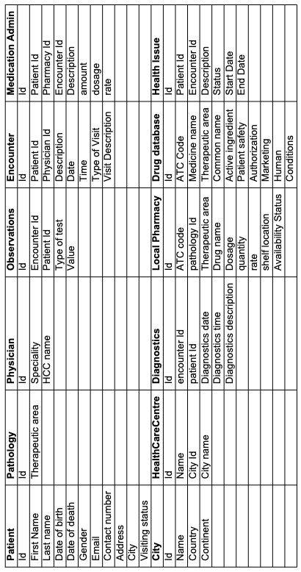
Entities Categorization
The common entities : Drug_database, Pathology and City.
The core entities: Health care centre, Local pharmacy, Patient and Physician
The contextual resources collected : Observations, Health issues, Diagnostics, Encounter and Medication administration.

Slide 9
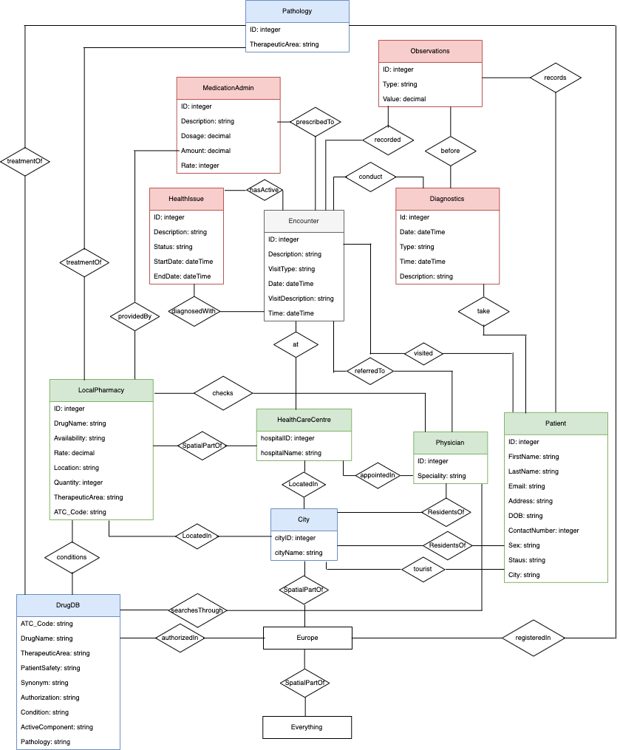
Informal Modeling
ER diagram: conceptualize our purpose considering the proposed CQs, built upon the defined scenarios.
Contextual teleology building.
Class hierarchy.

Slide 10
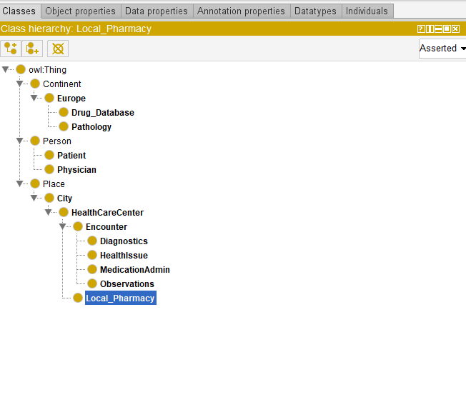
Ontology

Slide 11
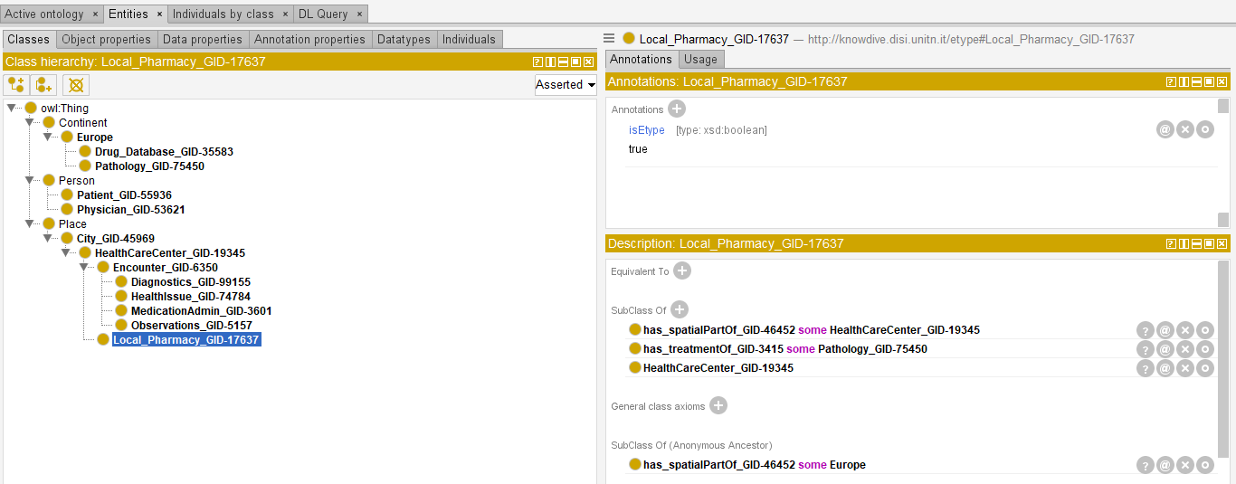
Formal Modeling
ETG (Entity Type Graph) generation
Protégé tool
Language alignment
KOS web tool

Slide 12
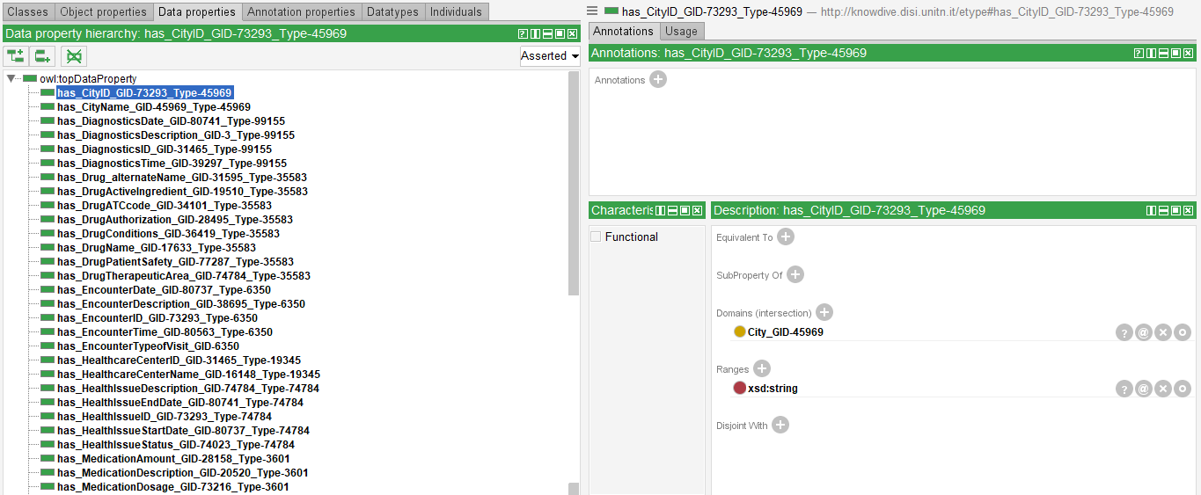
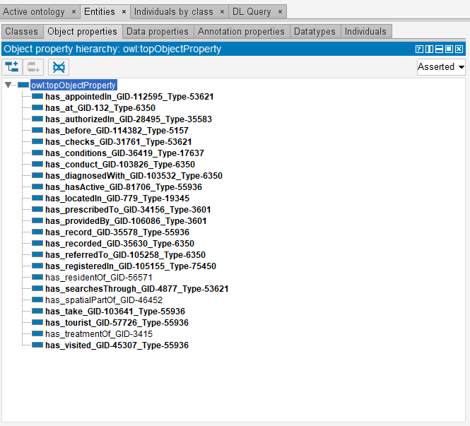

Slide 13
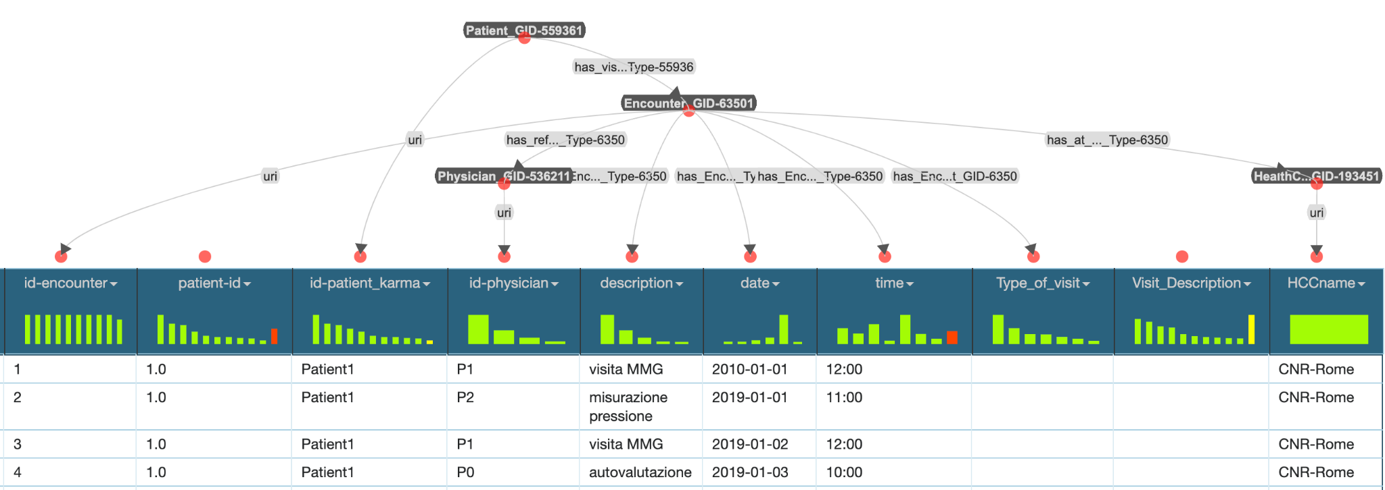
Data Integration
Formal teleontology-Data Integration
.ttl files produced for 12 classes (.owl file) and its corresponding dataset (.csv file)
URIs - for each class
Relationship links to URIs of another class with defined object properties

Slide 14
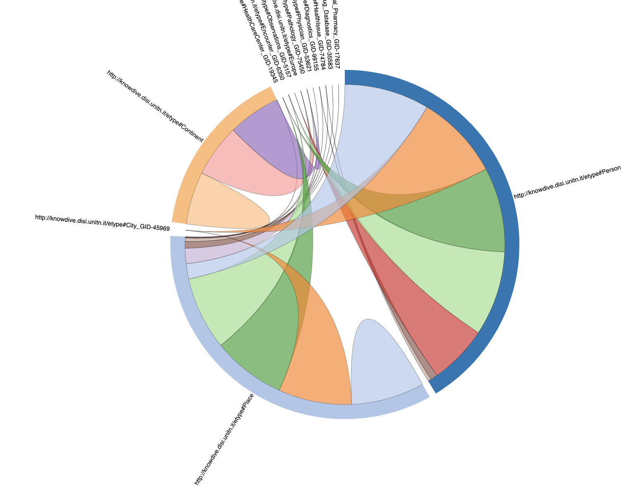
KG Construction & Exploitation
GraphDB
12 .ttl files imported
Linked Relationships
KG construction
Visualised graph for different classes.
SPARQL queries tested for each CQs

Slide 15
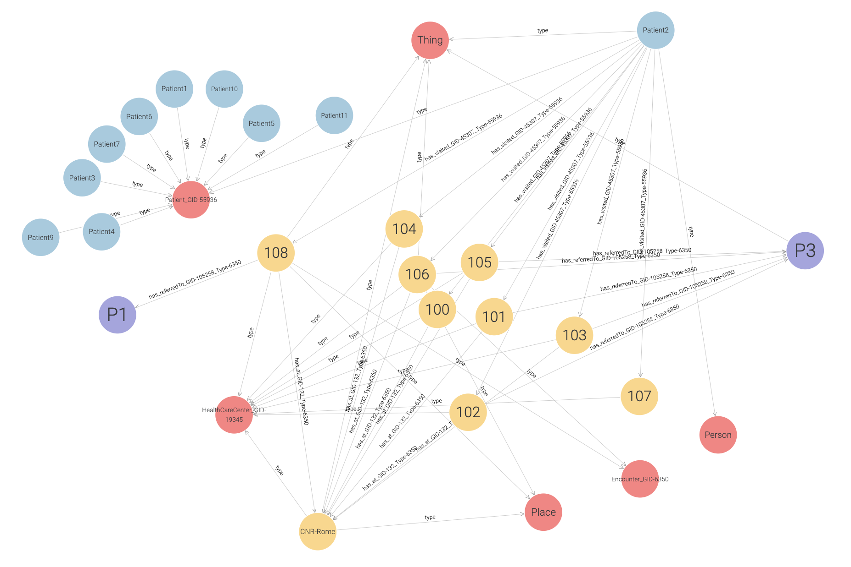
Knowledge graph exploitation for Patient: The Patient2 (blue) connects with P1 (purple), i.e., physician or MMG and P3 (purple), i.e. diagnostic tests through Encounters labelled in number 108 (yellow) to P1 and other Encounters (yellow) connected to P3 respectively. The several relationships are denoted on the edges. All encounters are linked to CNR-Rome (yellow): Healthcare Center.

Slide 16
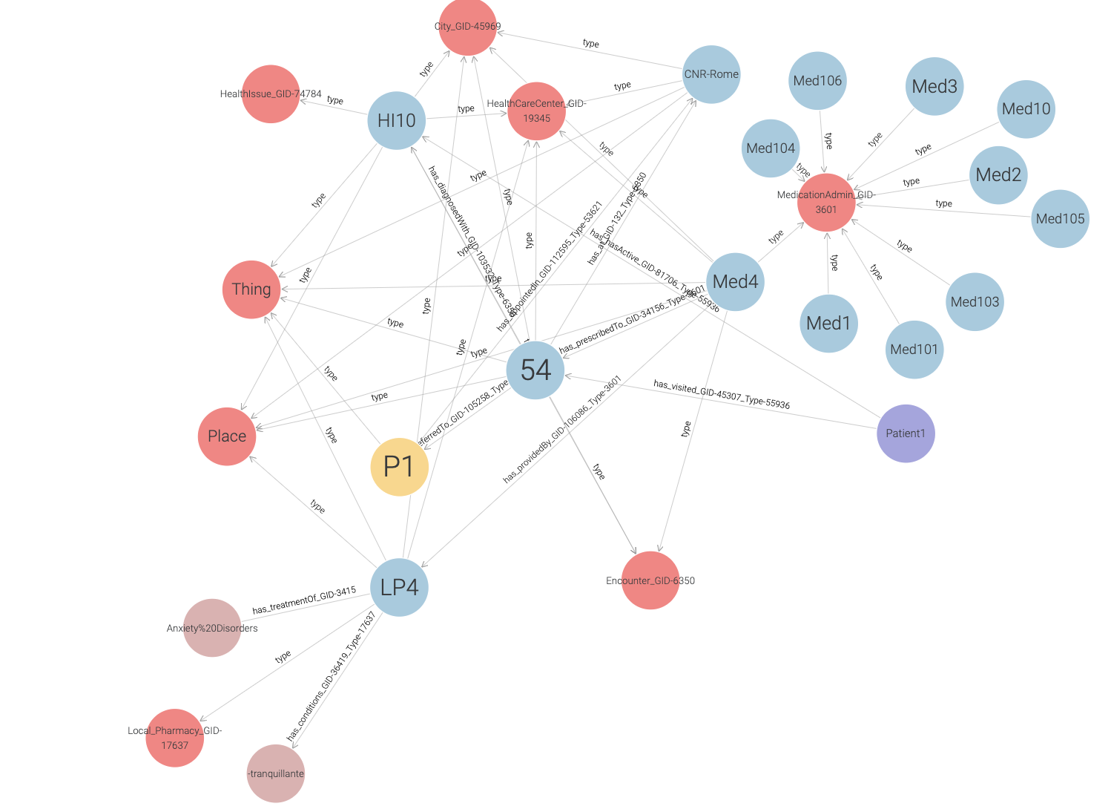
KG exploitation for Medication administration : Knowledge graph from teleontology integrated with the medication data of Patient1. The Med4 (blue) medication is administered to the patient at Encounter 54 (blue) with local pharmacy drug ID, LP4 (blue) for a given healthissue, HI10 (blue) the encounter number on the prescription by physician or MMG, P1 (yellow).

Slide 17
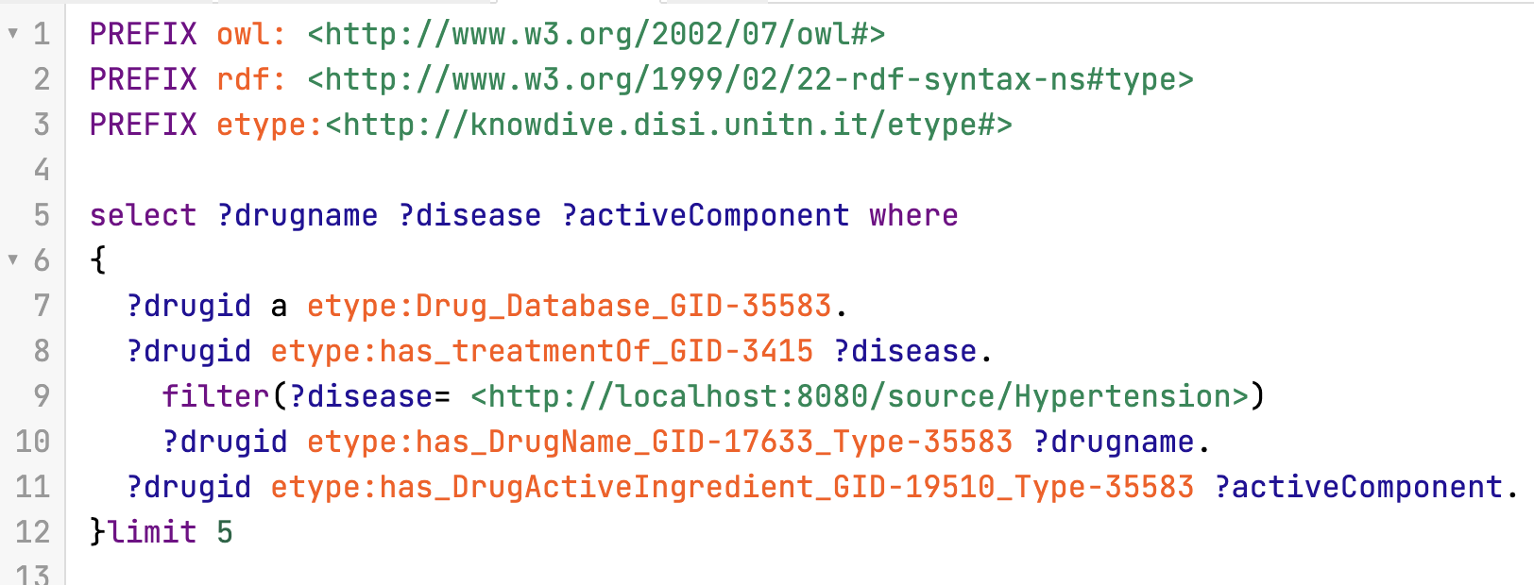
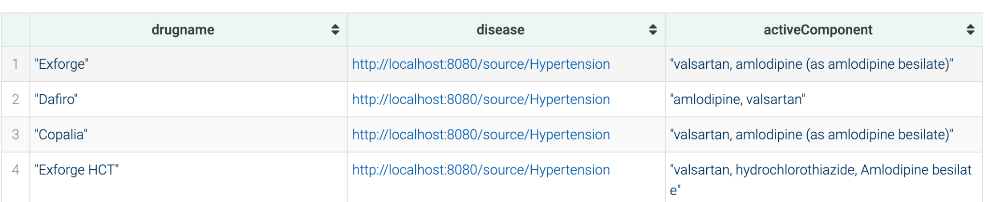
CQs tested with SPARQl query
Competency Question (CQ) : Pharmacist is looking for an active component/ingredient of the prescribed drug for the treatment of hypertension.

Slide 18
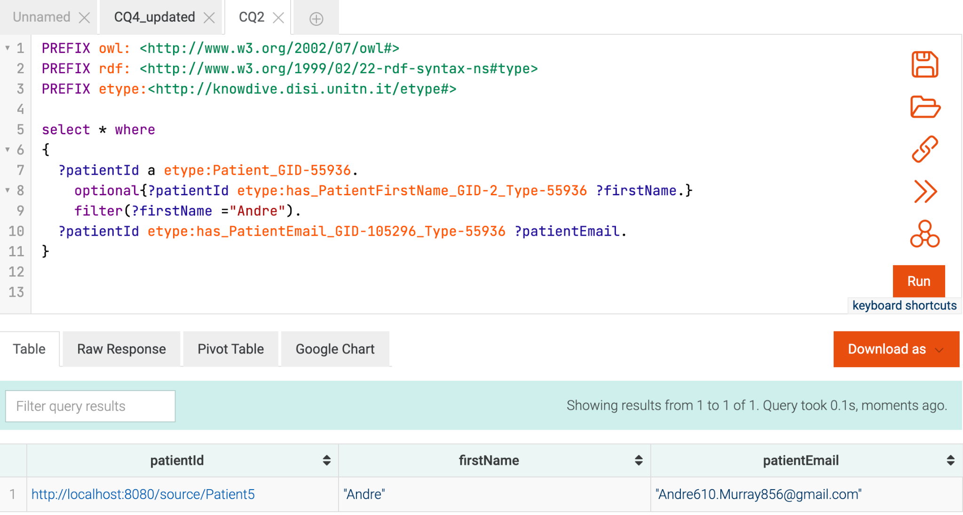
Competency Question: Hospital staff retrieves Andre email address to send him the diagnostic test results.

Slide 19
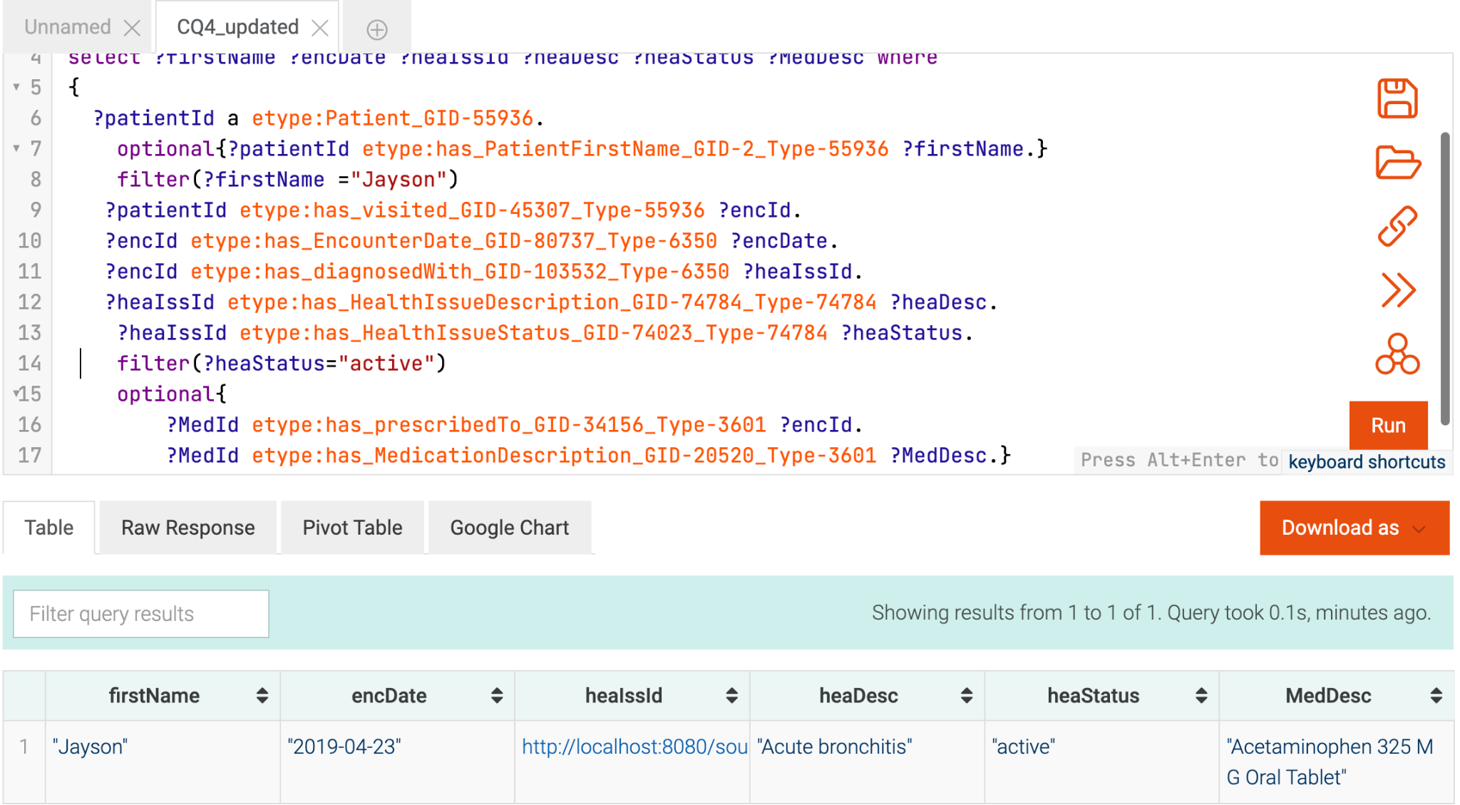
CQ : Physician wants to refer to the last medication prescribed to Jayson who is diagnosed with Acute bronchitis

Slide 20
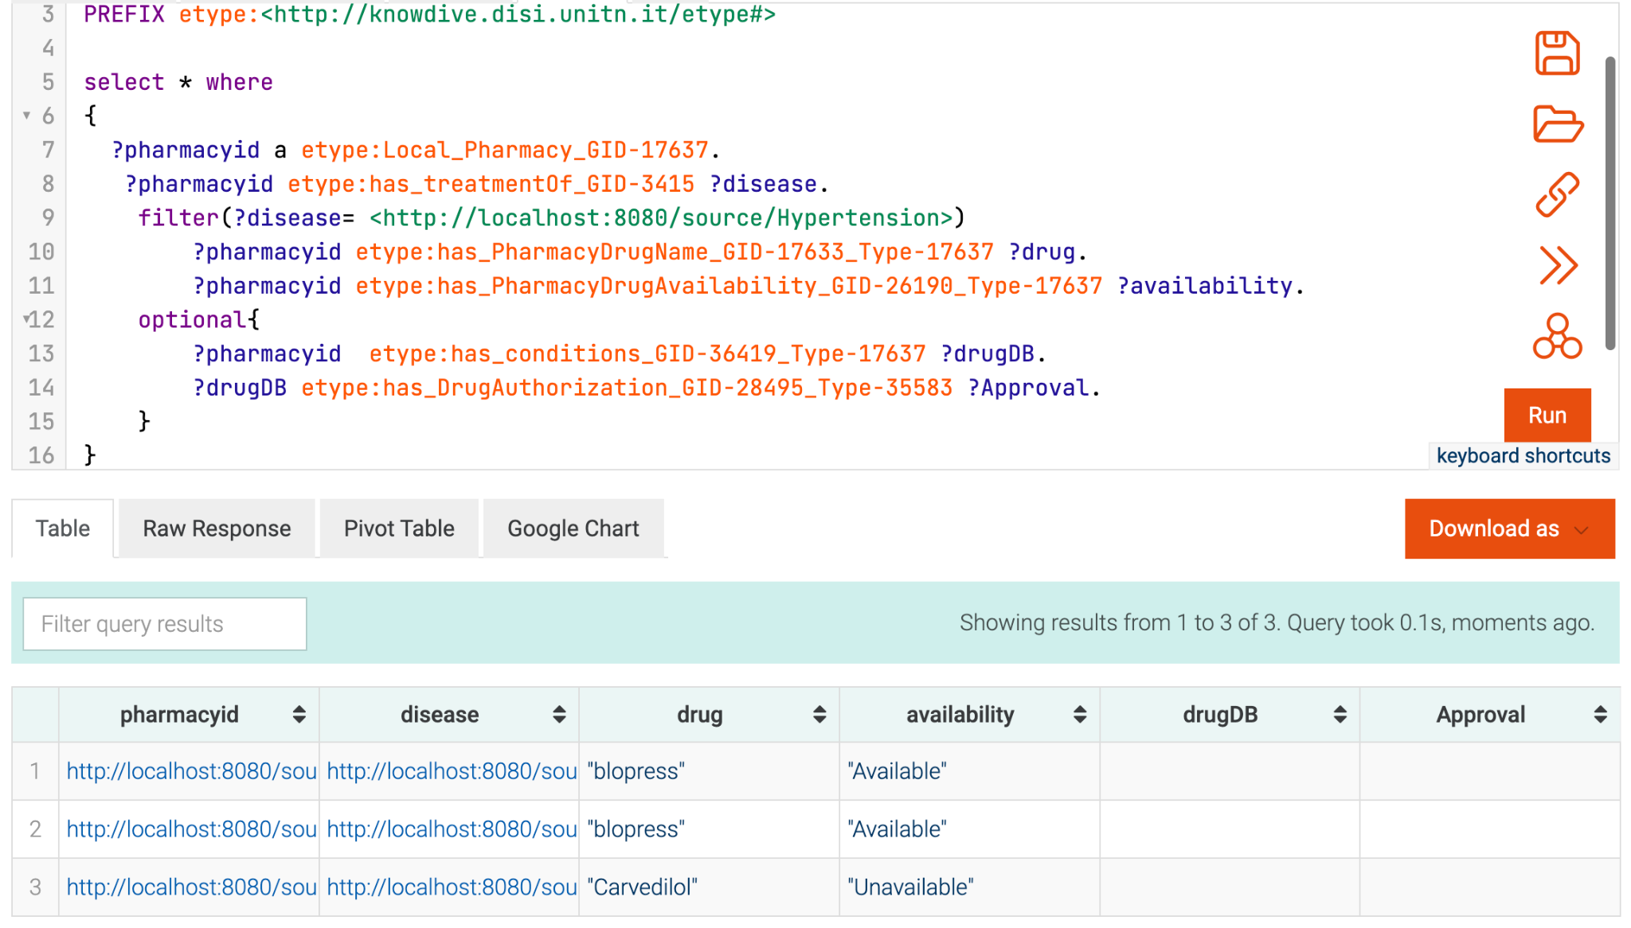
CQ: Clinician searches through the list of approved drugs that are available in the local pharmacy for hypertension.

Slide 21
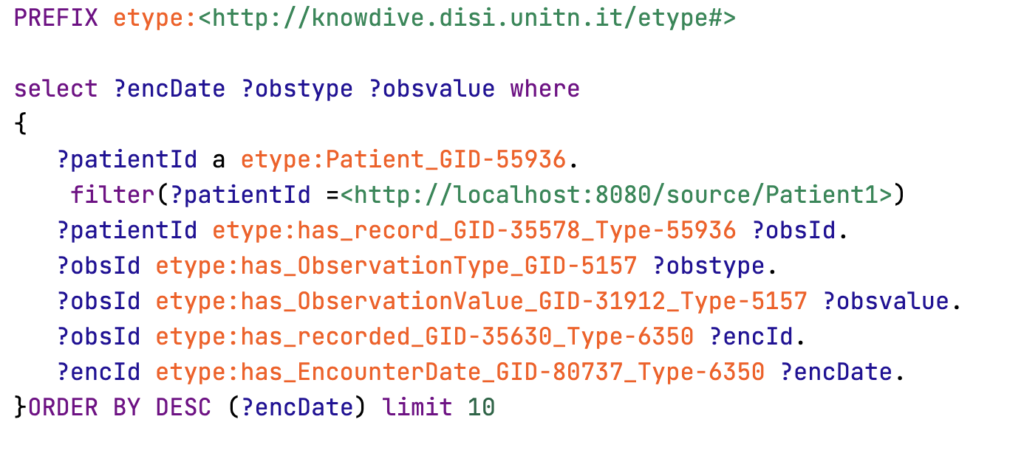
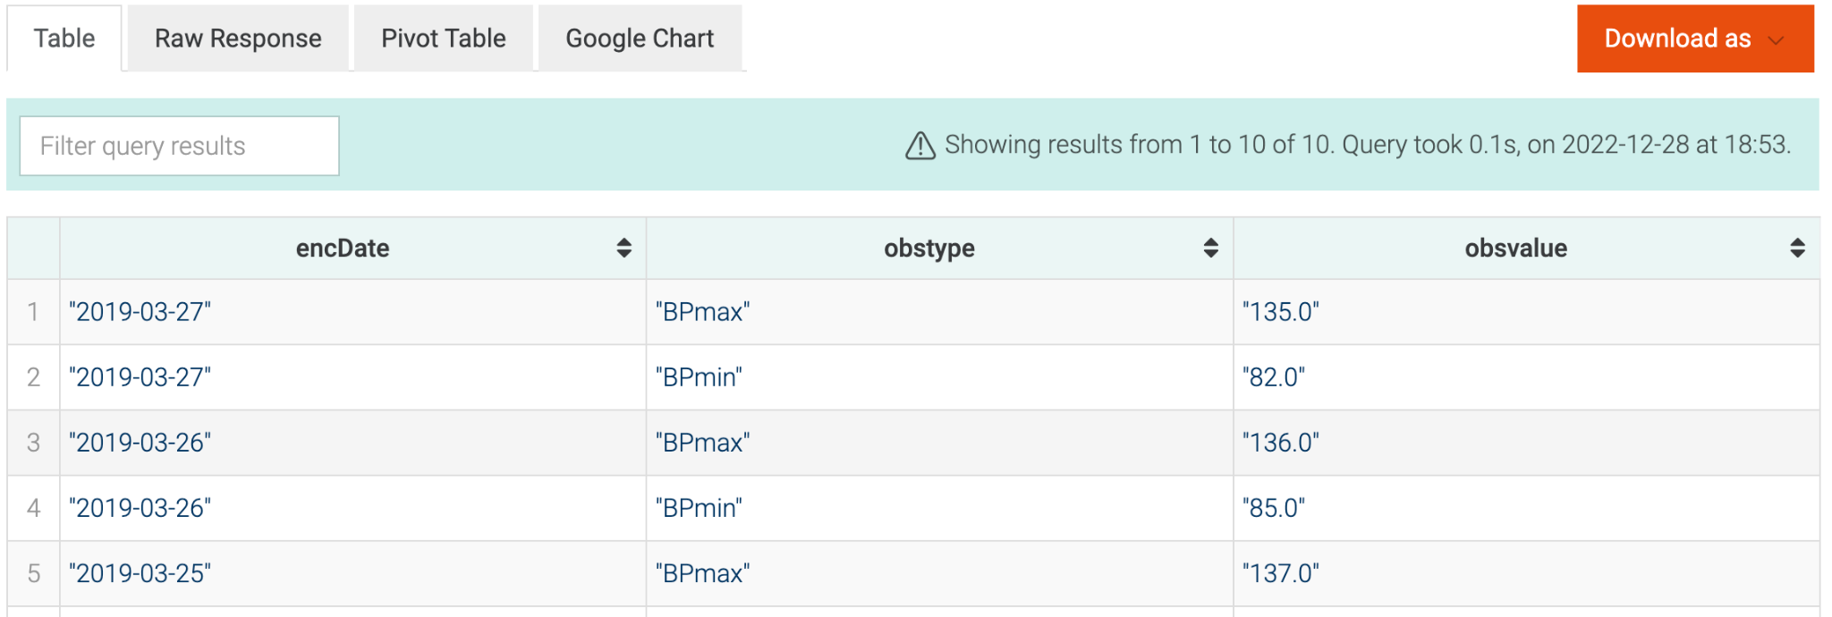
CQ: Patient1 records routine health observations and wants to track the whole record.

Slide 22
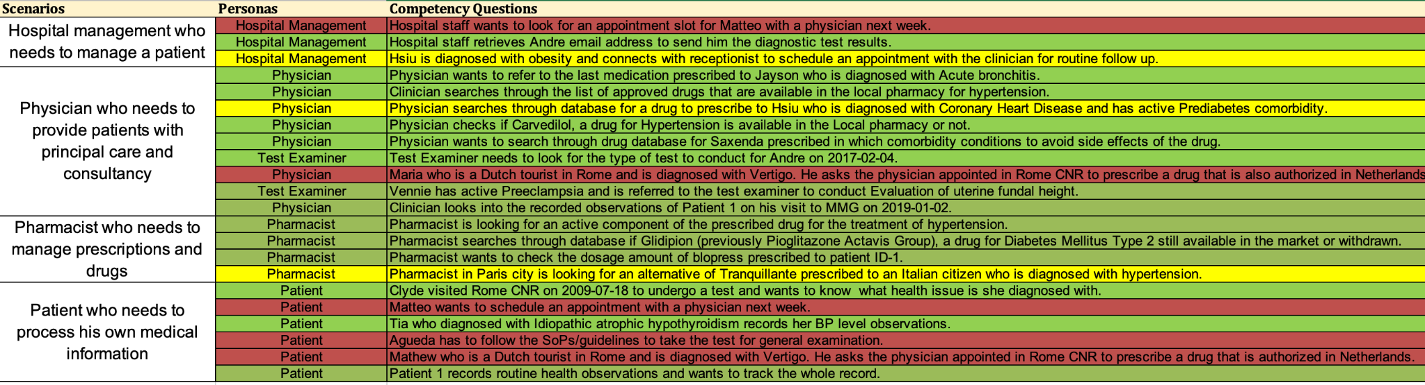
Figure 13: The competency questions, CQs which were answered with the SPARQL Query. Green represents the whole CQ query was resolved, yellow represents a certain part of the CQ was resolved, red represents the unresolved CQs.

Slide 23
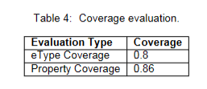
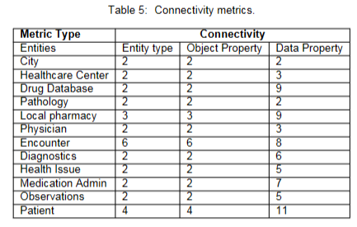
Evaluation

Slide 24
Open Issues
Different languages not integrated
Eg: a tourist visits CNR-Rome or goes to local pharmacy to buy his medicines.
Dataset unavailability:
SoPs/guidelines for the diagnostics tests.
Appointment scheduling
Country specific drug database
eg: Farmabank in Italy
Limited data
Only one hospital, one patient.

Slide 25
Conclusions and Future Aspects
Nearly 77% of the CQs (17 out of 22 CQs) fetched.
Covered important CQs related to medical and healthcare domain.
More datasets -> retain more information for all the patients -> help the hospital management share patients’ records and health status to other hospitals for diseases whose treatment facility unavailable in CNR-Rome without loss of time or medical information.
knowledge graphs -> help digitalization of the health care sector and devise methodologies for developing precision medicine for several patients in a fast pace.

Slide 26
References
1] Giunchiglia, F., Bocca, S., Fumagalli, M., Bagchi, M., Zamboni, A. (2021). iTelos-Building reusable knowledge graphs. arXiv preprint arXiv:2105.09418.
[2] Walonoski, J., Kramer, M., Nichols, J., Quina, A., Moesel, C., Hall, D., ... McLachlan, S. (2018). Synthea: An approach, method, and software mechanism for generating synthetic patients and the synthetic electronic health care record. Journal of the American Medical Informatics Association, 25(3), 230-238.
[3] Whirl-Carrillo, M., Huddart, R., Gong, L., Sangkuhl, K., Thorn, C. F., Whaley, R.,
Klein, T. E. (2021). An evidence-based framework for evaluating pharmacogenomics knowledge for personalized medicine. Clinical Pharmacology & Therapeutics, 110(3), 563-572.
[4] Musen, M. A. (2015). The protégé project: a look back and a look forward. AI matters, 1(4), 4-12.
[5] Knoblock, C. A., Szekely, P., Ambite, J. L., Goel, A., Gupta, S., Lerman, K., ...Mallick, P. (2012, May). Semi automatically mapping structured sources into the semantic web. In Extended Semantic Web Conference (pp. 375-390). Springer, Berlin, Heidelberg.

